Slide 1
Digital Image Processing
Malay S. Bhatt
Department of Computer Engineering
Faculty of Technology
Dharmsinh Desai University
Nadiad

Slide 2
Arithmetic Operations
Addition
For any two digital images, say f and g, the addition would yield the output image z with the arithmetic addition of the pixel values of f and g at the (x, y) co-ordinates respectively.
Subtraction
For any two digital images, say f and g, the addition would yield the output image z with the arithmetic addition of the pixel values of f and g at the (x, y) co-ordinates respectively.
Multiplication
For any two digital images, say f and g, the addition would yield the output image z with the arithmetic addition of the pixel values of f and g at the (x, y) co-ordinates respectively.
Division
For any two digital images, say f and g, the addition would yield the output image z with the arithmetic addition of the pixel values of f and g at the (x, y) co-ordinates respectively.

Slide 3
Addition Operation
IMAGE 1
IMAGE 2
IMAGE 1 + IMAGE 2
0
0
0
0
100
0
0
0
100
0
0
0
0
100
100
0
0
100
0
0
0
200
100
0
0
100
100
0
0
0
100
0
0
100
200
0
0
0
0
0
0
0
0
100
0
0
0
100

Slide 4
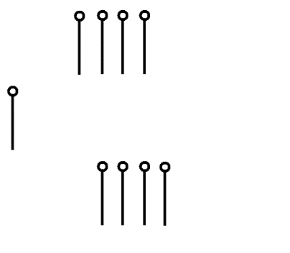
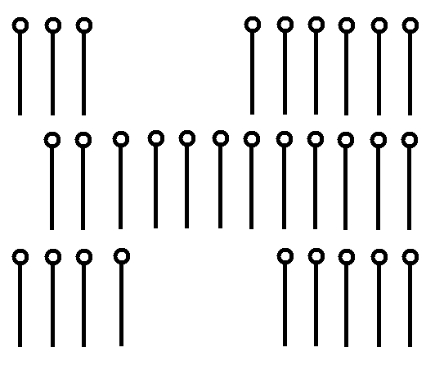
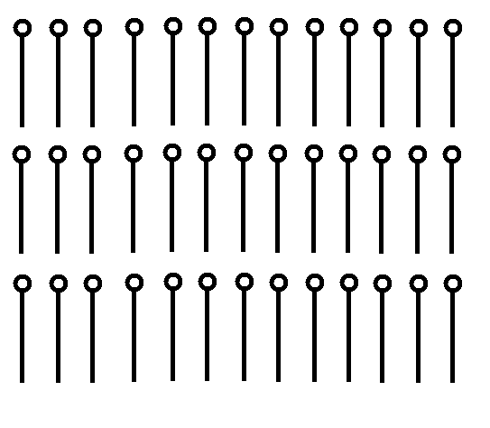
Arithmetic Operation (Addition)
clear;
clc;
img1=imread('D:\Imageprocessing\IP_sttp\sticks3.bmp');
img2=imread('D:\ImageProcessing\IP_sttp\sticks2.bmp');
img1=double(img1);
img2=double(img2);
imshow(img1);
figure,imshow(img2);
final=img1 + img2;
final=mat2gray(final);
imwrite(final,'D:\Image Processing\IP_sttp\sticks.bmp');
figure, imshow (final);

Slide 5
Subtraction Operation
IMAGE 1
IMAGE 2
IMAGE 1 - IMAGE 2
0
0
0
0
100
0
0
0
-100
0
0
0
0
0
100
100
0
0
100
0
0
0
0
100
0
0
100
100
0
0
0
100
0
0
100
0
0
0
0
0
0
0
0
0
100
0
0
0
-100
0
Image subtraction is a basic tool in medical imaging, where it is used to remove static background information

Slide 6
Arithmetic Operation (Subtraction)
clear;
clc;
img1=imread('D:\Image processing\IP_sttp\sticks.bmp');
img2=imread('D:\Image processing\IP_sttp\sticks2.bmp');
img1=double(img1);
img2=double(img2);
imshow(img1);
figure,imshow(img2);
final=img1 -img2;
final=mat2gray(final);
imwrite(final,'D:\Image Processing\IP_sttp\sticks3.bmp');
figure, imshow (final);

Slide 7
Multiplication Operation
IMAGE 1
IMAGE 2
IMAGE 1 * IMAGE 2
0
0
0
0
100
0
0
0
-100
0
0
0
0
0
100
100
0
0
100
0
0
0
10000
255
0
0
0
100
100
0
0
0
100
0
0
0
10000
255
0
0
0
0
0
0
0
0
100
0
0
0
-100
0

Slide 8
Arithmetic Operation (Multiplication)
clear;
clc;
img1=imread('D:\Imageprocessing\IP_sttp\sticks3.bmp');
img2=imread('D:\ImageProcessing\IP_sttp\sticks2.bmp');
img1=double(img1);
img2=double(img2);
imshow(img1);
figure,imshow(img2);
final=img1 .* img2;
final=mat2gray(final);
imwrite(final,'D:\Image Processing\IP_sttp\sticks.bmp');
figure, imshow (final);

Slide 9
Division Operation
IMAGE 1
IMAGE 2
IMAGE 1 / IMAGE 2
0
0
0
0
100
0
0
0
-100
0
0
0
0
0
100
100
0
0
100
0
0
0
1
0
0
0
100
100
0
0
0
100
0
0
0
1
0
0
0
0
0
0
0
0
100
0
0
0
-100
0

Slide 10
Arithmetic Operation (Division)
clear;
clc;
img1=imread('D:\Image processing\IP_sttp\sticks.bmp');
img2=imread('D:\Image processing\IP_sttp\sticks2.bmp');
img1=double(img1);
img2=double(img2);
imshow(img1);
figure,imshow(img2);
final=img1 ./img2;
final=mat2gray(final);
imwrite(final,'D:\Image Processing\IP_sttp\sticks3.bmp');
figure, imshow (final);

Slide 11
Logical Operations
This operators are used for masking. White pixels are represented by binary 1 while black pixels are represented by binary 0.
AND
For any two digital images, say f and g, the AND would yield the output image z with the logical AND of the pixel values of f and g at the (x, y) co-ordinates respectively.
NOT
impact of NOT is exactly same as achieving the Negative Image
OR
For any two digital images, say f and g, the OR would yield the output image z with the logical OR of the pixel values of f and g at the (x, y) co-ordinates respectively.

Slide 12
AND Operation
IMAGE 1
IMAGE 2
1 AND 2
0
0
0
255
255
255
255
255
0
0
0
255
0
0
0
255
255
0
0
0
0
0
0
0
0
0
0
255
255
0
0
0
0
0
0
0
255
255
255
255
255
0
0
0
255
0
0
0

Slide 13
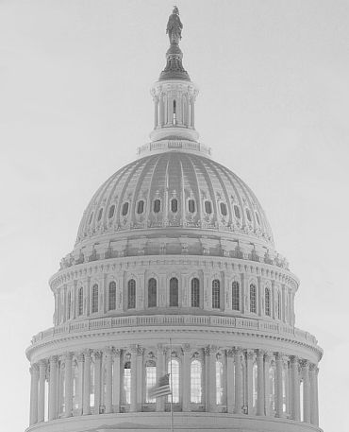

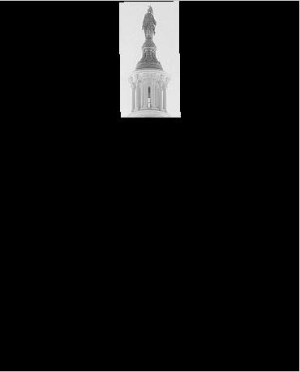
Logical Operation (AND)
Clear;
Clc;
img3=imread(‘E:\Building.jpg’);
BW=roipoly(img3);
img3=double(img3);
BW=double (BW);
final=img3 .* BW;
img3=mat2gray(img3);
BW=mat2gray(BW);
final=mat2gray(final);
figure, imshow(img3);
figure, imshow(BW);
figure, imshow (final);

Slide 14
OR Operation
IMAGE 1
IMAGE 2
1 OR 2
0
0
0
255
255
255
255
255
255
255
255
255
0
0
0
255
255
0
0
0
255
0
0
255
0
0
0
255
255
0
0
0
255
0
0
255
255
255
255
255
255
0
0
0
255
255
255
255

Slide 15

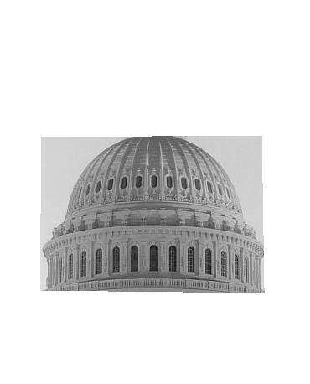
Logical Operation (OR)

Slide 16
Image Transformation
Geometric transformation modify spatial relationship between the pixels in an image. These are known as rubber-sheet Transformation.
Transformation includes basically three operations : Translation, scaling and rotation
Scaling indicates zooming of an image or shrinking of an image
Translation translates an image into another form.
Example is
A = A + 100

Slide 17
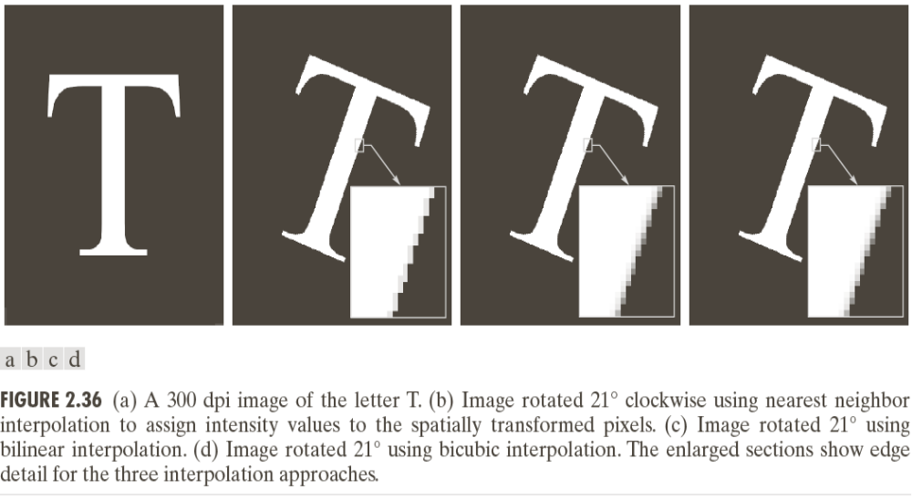
Image Transformation (Rotation)

Slide 18
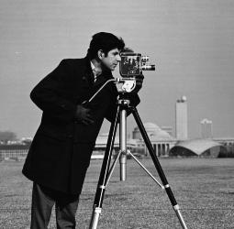
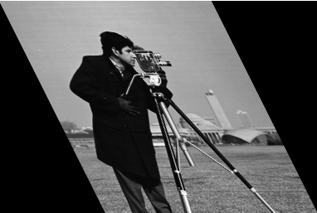
Image Transformation (Shear)

Slide 19
Image Registration
To align two or more images of the same scene.
In case of transformation, form of the transformation function required to achieve a desired geometric transformation was known.
In image registration, input and output images are known, transformation that produce output image from input image is unknown.
The problem is to estimate transformation function and use it to register two images.
Input image is the image which we wish to transform, and what we call the reference image as the image against which we wish to register the input.

Slide 20
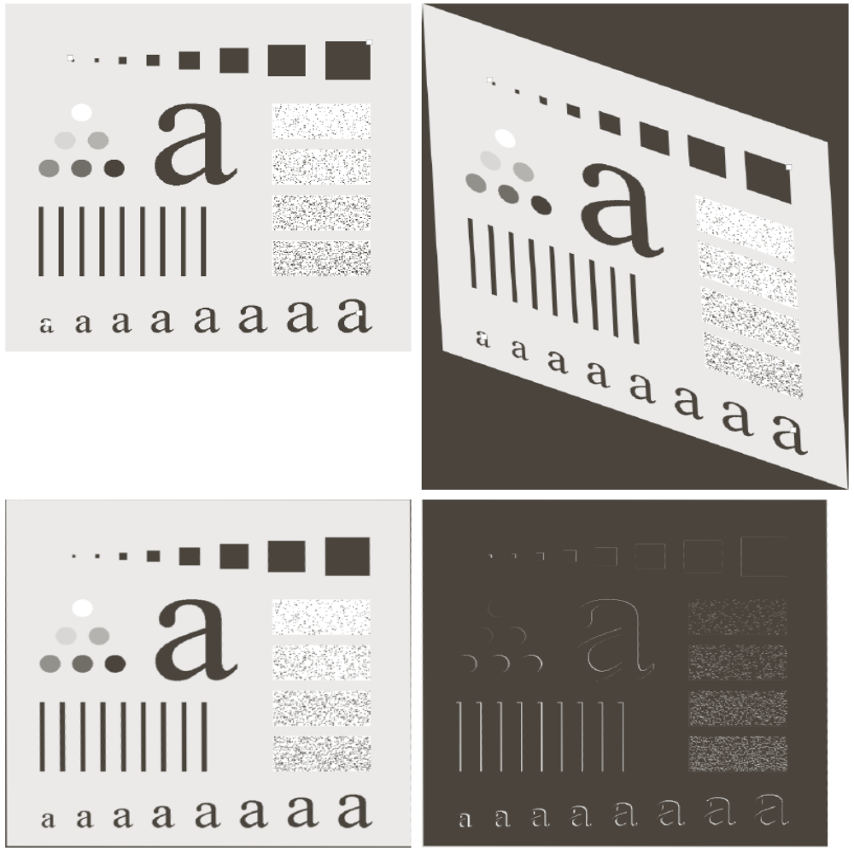
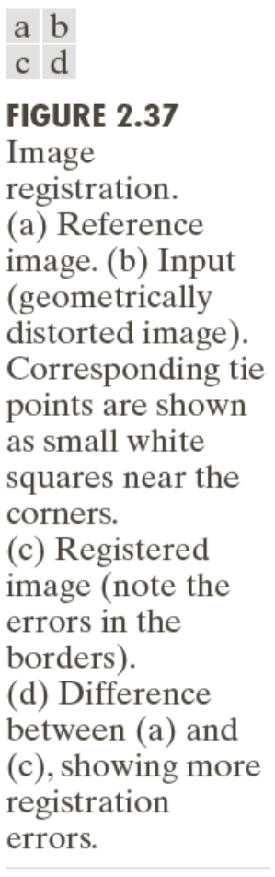
Image Registration

